Slide 1
Introduction to Oceanography: All about water!
Water vapor in the atmosphere
NASA Goddard Space Flight Center
Notes:
As we look at this animation of our planet from NASA we see that more of Earth’s surface is covered with water in the form of the oceans than land. We can also see a lot of water vapor in the atmosphere. Water is why our planet has life. Water as a substance is incredibly important in oceanography and also to our planet as a whole.

Slide 2
After this lesson you should be able to:
Describe the bonds both within the water molecule and that the water molecules form with each other and other substance
Differentiate cohesion and adhesion and identify examples of each
Differentiate temperature and heat
Predict the effect of physical state changes on bodies of water
Connect the concept of specific heat with the effect of Earth’s ocean on Earth’s climate
Predict how water density is affected by changing pressures and temperatures
Notes:
In this lesson we will learn about the structure of the water molecule and how it behaves chemically. We will learn some new terms while carefully defining some terms you may already be familiar with. We’ll apply these terms to the behavior of water in both your everyday life and in the ocean. Here are some learning outcomes that you can come back to after the lesson is over, to make sure you can do all of the outcomes listed here.

Slide 3
The water molecule
Water
Notes:
We take water for granted because we’ve been observing it in our daily lives forever. But in reality, water is a really strange substance that does some things that are chemically kind of weird!

Slide 4
Water is a molecule, H₂O
One oxygen, two hydrogens!
Review atoms and molecules here
3-D Model via Microsoft Remix 3D, by user DinanBlueje
Notes:
Let’s start with the chemical nature of water itself. Even though many people are not particularly fond of chemistry class, almost anyone can give you the chemical formula for water: H₂O. Water is composed of three atoms, making it a molecule. The molecule is composed of an oxygen atom and two hydrogen atoms.

Slide 5
The bonds within H₂O molecules are covalent, with shared electrons between the H and O
-
H
-
-
-
-
O
-
-
-
-
-
H
Review types of chemical bonds here
Notes:
Atoms are composed of a nucleus of protons and neutrons and outer rings of negatively-charged electrons that orbit the nucleus. The inner ring can accommodate two electrons, and the second ring can accommodate eight. If the second ring is not completely full, atoms may share electrons, which then orbit both nuclei. This bonds them together, forming a covalent bond, and causing a molecule to form.

Slide 6
Electrons spend more time around O than around H, so the O end of the molecule is slightly negative, the H end is slightly positive
-
H
-
-
-
-
-
+
O
-
-
-
-
-
H
Review types of chemical bonds here
Notes:
In the case of the water molecule, oxygen has a bigger nucleus than hydrogen does. So the shared electrons spend more time orbiting the oxygen nucleus and less time orbiting the hydrogen nuclei. Electrons carry a negative charge, so the extra time they spend with the oxygen gives it a slightly negative charge, leaving the two hydrogens slightly positive.

Slide 7
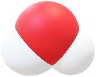
Because H₂O molecules are polar, they are attracted to each other and form weak “hydrogen bonds*”
HYDROGEN BOND
-
+
These “bonds” are weak but constantly form and reform, giving water unique qualities for a liquid
*technically not a true chemical bond
Notes:
Because one end of the water molecule is slightly positive and the other is slightly negative, water molecules are attracted to each other sort of like magnets. The negative end tends to stick to the positive end of another water molecules forming a weak bond that is not a true chemical bond. These “hydrogen bonds” are much weaker than the very strong covelent bonds that caused the water molecule to form in the first place. Do you have a water bottle sitting on your desk? If so, the water molecules in it are constantly forming and breaking these hydrogen bonds as we work through this lesson.

Slide 8
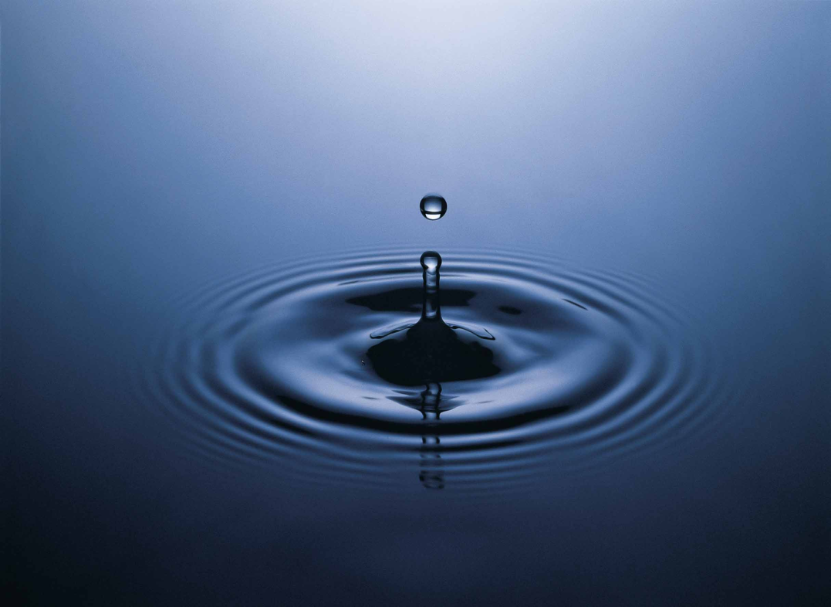
Cohesion is the tendency of water molecules to bond with each other (“stick together”)
At any given time, a certain % of molecules are bonded, giving water more structure than most other liquids
USDA Natural Resources image
Notes:
Because of this polarity (meaning one end is different than the other) and the resulting weak hydrogen bonds, water molecules constantly bond together. This property is known as cohesion, meaning that the molecules like to “stick together”. Water, like most liquids, looks very structureless, but in fact, water has more structure within it that many other liquids have, because of its cohesion.

Slide 9
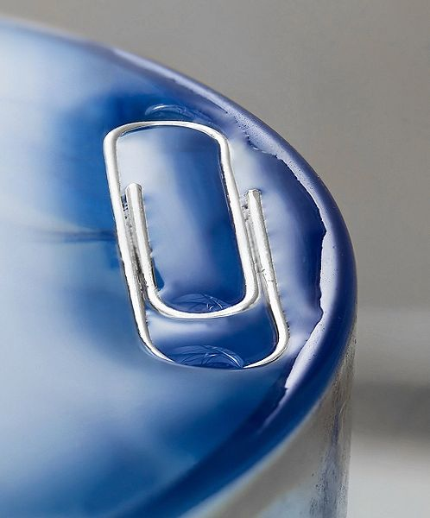
Surface tension is related to cohesion and is a measure of how easy it is to stretch/penetrate the surface of a liquid
Water has the highest surface tension of common liquids!
Good explanation of cohesion and surface tension: click here or here
This photo by Unknown Author are licensed under CC BY-NC
Notes:
One really evident manifestation of water’s cohesion can be seen in its surface tension. If you try really carefully, you could get a paper clip to “float” on a glass of water, as shown in the picture. The reason you can do this is because water forms a surface that resists being stretched or penetrated. This is unusual for liquids, and even for water the surface tension is relatively weak. Try the paper clip trick to see what I mean. It’s kind of tricky!

Slide 10
At an air/water interface, water molecules bond to create a weak membrane
Notes:
The surface tension is because water forms a weak membrane on its surface. Why does it do that? Well, remember cohesion. Water molecules like to stick together, forming hydrogen bonds. Within your water bottle the molecules are constantly forming and breaking bonds with each other in all directions. But, at the very surface, the water molecules can only bond with the molecules below or beside them, not above them, because there aren’t any. So the bonds they make with the fewer molecules around them are more concentrated, and that is what creates the membrane that gives water surface tension.

Slide 11
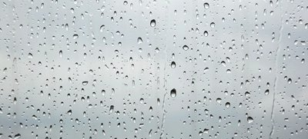
Water molecules also exhibit adhesion. They like to stick to other substances.
Water droplets on a window stick to the window because of adhesion. They form droplets because of cohesion.
What is the difference between adhesion and cohesion? Click here: http://water.usgs.gov/edu/adhesion.html
This photo by Unknown Author are licensed under CC BY-NC
Notes:
But, water molecules also like to stick to other substances, which we call adhesion. Look at this picture of water droplets on a window pane. This is something we’ve observed all of our lives, yet you’ve probably never stopped to think about what is going on here. Why does the water form droplets? The droplets form because the water has cohesion. The water molecules like to stick together, so they “bundle up” to form water droplets. But water flow downhill due to gravity, right? So why do the droplets stay on the window? We know that if the droplets get big enough, they will roll down the window as some already have. But the smaller ones stay put, because the attraction between the water and the window surface is stronger than gravity, up to a point.

Slide 12
The ability of water to dissolve salt is related to the polarity of the water molecule
The positive end of the molecule (H) is attracted to negative ions
Na⁺
Cl⁻
The negative end of the molecule (O) is attracted to positive ions
In either case, the water molecules surround the ions and keep them from interacting with each other
Notes:
So water is attracted to other substances. This explains one of the key facts that most people know about the ocean- it’s salty! After the chemical formula for water, probably the second-most widely known chemical formula is table salt, NaCl. Sodium (the chemical abbreviation Na) by itself has a positive change, while chlorine (Cl) has a negative charge. In your salt shaker, they form a molecule and a solid because the positive sodium bonds with the negative chlorine. But in water, salt quickly dissolves because the water molecules, with their polarity, are also attracted to both the sodium and the chlorine. The negative oxygen ends of the water molecule are attracted to the sodium and the positive hydrogen ends are attracted to the negative chlorine. The water molecules surrounded these charged atoms (known as ions) and keep them from interacting and bonding to make a solid salt.

Slide 13
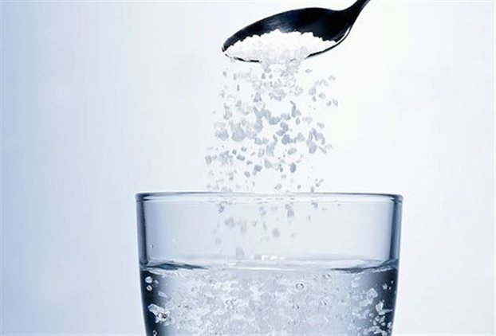
Water is the universal solvent
Read more about water as a universal solvent here: https://water.usgs.gov/edu/solvent.html
This photo by Unknown Author are licensed under CC BY-NC-ND
Notes:
Lots of other substances besides salt will dissolve in water in the same way- think Kool-Aid! For this reason we refer to water as the universal solvent. Ocean water has lots of dissolved salt in it, but it is rare for even freshwater to be completely pure. Most water, including your drinking water, has at least some substances dissolved in it.

Slide 14
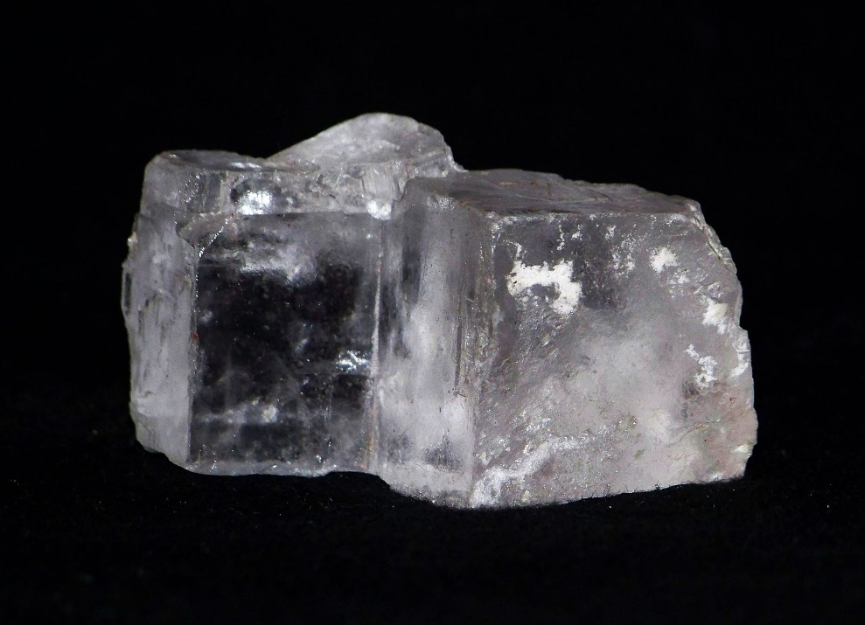
A salt is formed from a positive ion and a negative ion that neutralize each other
The ocean has many kinds of salts dissolved within, although NaCl (“table salt”) is most abundant.
Rock salt (NaCl)
Image: Piotr Sosnowski. This file is licensed under the Creative Commons Attribution-Share Alike 4.0 license.
Sylvite K salt (KCl)
Image: Luis Miguel Bugallo Sánchez. This file is licensed under the Creative Commons Attribution-Share Alike 3.0 license.
Notes:
We’ve tossed around the word “salt” without really defining it, but “salt” is a broader word that its use in “table salt” would indicate. A salt is a substance that forms from a positive ion and a negative ion bonding together to neutralize each other. So table salt is one, but we can also get KCl, potassium plus chlorine, and many more. Ocean water contains many positive and negative ions that stay dissolved because of the polar nature of the water molecule.

Slide 15
Temperature, Heat and the States of Water
Water in its three states
Notes:
We all know that water can exist at a range of temperature. It can very cold or very hot. Yet most of us would be hard-pressed to define what we mean by “heat” or “hot”. So let’s talk about these concepts as they relate to water and the ocean.

Slide 16
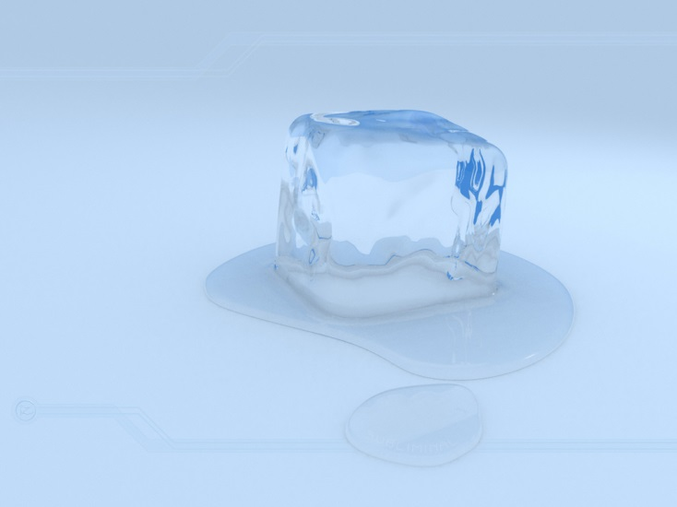
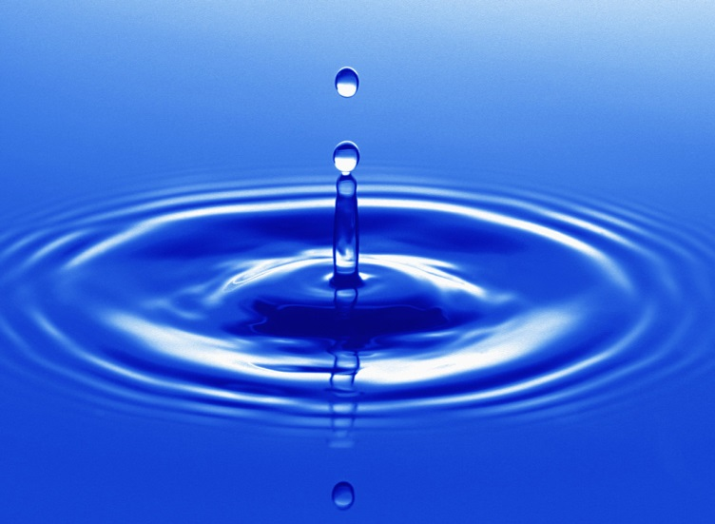
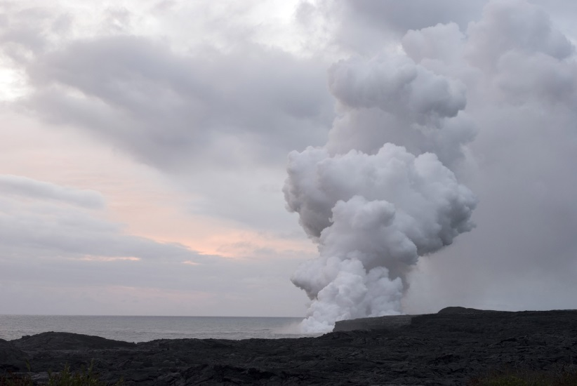
Temperature is the average kinetic energy (movement energy) of atoms & molecules in a substance
Explore the relationship between kinetic energy and temperature here
These photos by Unknown Author are licensed under CC BY-NC
Notes:
Remember that water molecules are constantly bonding with each other and also breaking those bonds. That is because the water molecules are constantly moving. The movement represents energy. The more the molecules are moving, the more energy there is. The temperature of water is a measure of how much movement energy, which we call kinetic energy, there is in the body of water.

Slide 17
Practice problem: In which of these substances are the molecules moving fastest?
A
B
C
These photos by Unknown Author are licensed under CC BY-NC
Notes:
As we look at these pictures, try to determine which of these substances has the highest kinetic energy. In which picture are the water molecules moving the fastest? I’ll count slowly to five silently to give you time to pause the video if you’d like to take some time to think before I explain the answer to the practice problem. (Pause) The pictures show A, an ice cube, B, a pool of water, and C, steam coming out of a geyser. So we have water as a solid, a liquid, and as steam. We intuitively know that steam is really hot. Steam is hot—it has a high temperature—because it has a high kinetic energy. The water molecules are moving around really, really fast compared to the liquid water and the ice cube. The solid ice cube looks like the water molecules probably aren’t moving at all. That is actually incorrect. Even in the ice cube there is kinetic energy, just less so than in the liquid water or steam.

Slide 18
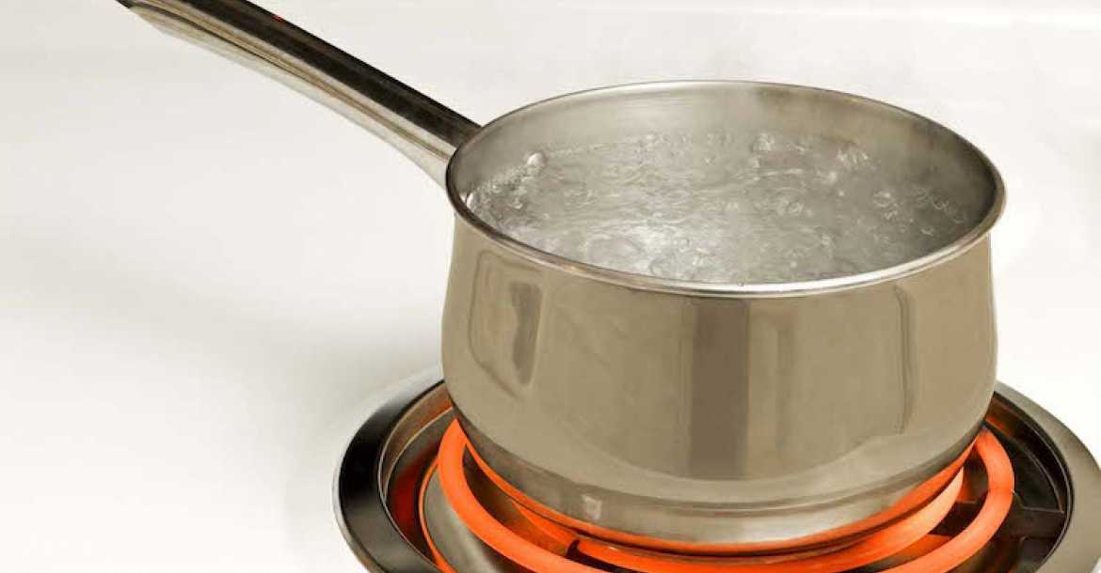
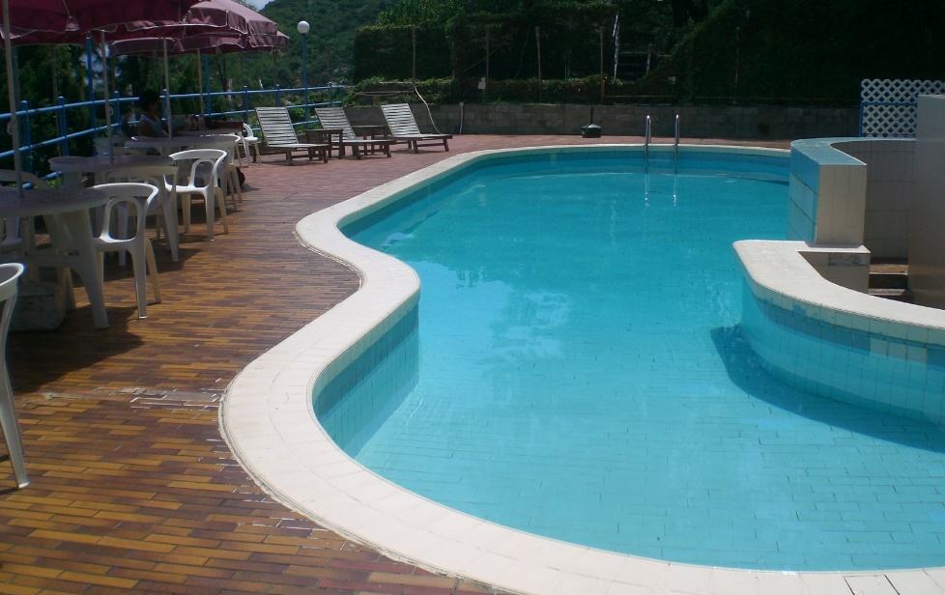
Heat is the total amount of kinetic energy of atoms and molecules in a substance
Hotter, but contains less total heat
Cooler, but contains more total heat
These photos by Unknown Author are licensed under CC BY-NC
Notes:
That brings us to our next, related, concept, which is heat. Heat is the total amount of kinetic energy in a body of water. So on the left we have a pan of water about to boil, and on the right, a swimming pool. The water in the pot is very hot; the water in the swimming pool is pleasantly cool. But there’s only a small amount of water in the pot, and there’s a vast amount of water in the pool. So if we added up all the kinetic energy stored in the pool, because it’s SO much water (even though it’s cooler), there’s a lot more heat stored in the pool overall than in the pot of boiling water.

Slide 19
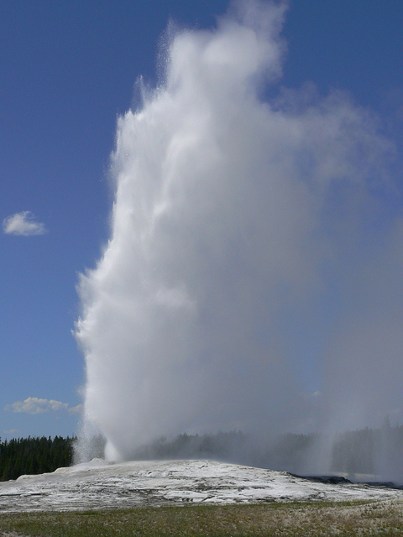
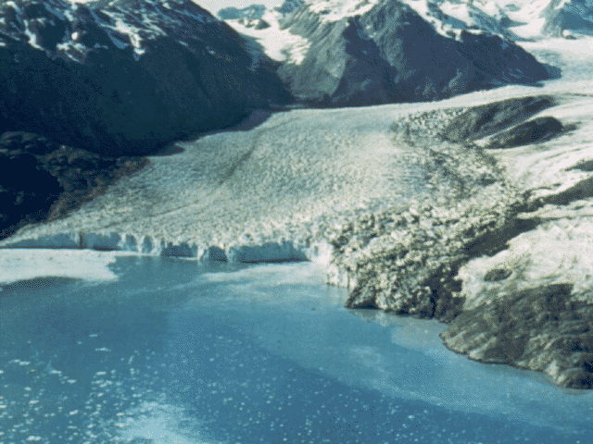
Practice Problem: Which has the higher temperature?
B
A
Photos: Microsoft Clipart
Notes:
So let’s apply these two concepts. On the right we have a glacier entering the ocean, and on the left we have a geyser erupting with steam. You probably don’t need to pause to answer the question—which is hotter; which has the higher temperature? Clearly the steam and hot water droplets coming out of the geyser would be much hotter that the glacier and the cold ocean around it.

Slide 20
Practice Problem: Which contains more heat?
B
A
Photos: Microsoft Clipart
Notes:
But which of these scenarios contains the most heat? (Pause) It may be counterintuitive, but the glacier contains much more heat than the geyser because it’s much, much bigger, containing a lot more water. We know ice is cold so it’s hard to imagine that it contains any heat at all. But, as I discussed with the ice cube a minute ago, even in the ice the water molecules are moving around a little bit, and that kinetic energy is heat. So while ice may not contain a lot of heat by volume, when you have a lot of ice, as here, that ice represents a lot of heat.

Slide 21
Water on Earth exists in all three physical states: solid, liquid, and gas
An iceberg on a cloudy day in Iceland: Water in all three physical states
(Photo by R. Freeman)
Notes:
One the really neat things about our planet is that it is at the right range of temperatures that water can exist in all three of what we call its “physical states”. I took this picture in Iceland at a place where a glacier was breaking up as it entered the ocean. The beach was littered with mini icebergs that had washed up. It was a cold day, cold enough that the little icebergs were melting very very slowly. But it wasn’t so cold that the ocean was freezing solid. It was a cloudy day, and I could see clouds of water droplets in sky. The clouds had formed from water vapor, a gas that is in the atmosphere. In the water cycle on our planet water moves between these three physical states as it moves from place to place.

Slide 22
Freezing, melting, and evaporating and condensing are ways to change the state of water
Melting- add 80 calories
Evaporating- add 540 calories
Warming: add 100 calories
SOLID
0ºC
LIQUID
100ºC
GAS
Cooling: remove 100 calories
Freezing- subtract 80 calories
Condensing- subtract 540 calories
To go from one state to another, heat must be added or subtracted
Images:
Creative Commons
Notes:
So how does water move from one state to another? We’re really familiar with these pathways from our everyday life. Ice can melt as solid water turns to liquid water. Why does it do that? It does that because we’ve added heat which increases the kinetic movement of the water molecules within the body of water. Calories are measurement units of heat. In this diagram, we are considering what can happen to a gram of water. If we have a 1 gram ice cube and we want to melt it, we have to add heat, 80 calories worth. Note that the melting temperature of ice is 0. While we are adding the heat, before the ice melts, the temperature stays at 0 until we have added the 80 calories, and then it melts. Similarly if wanted to freeze water, we’d have to subtract 80 calories of heat at 0 degrees before it would freeze into ice.
But what if the water that we wanted to freeze wasn’t at 0? What it if it were at 50 degrees? We’d have to subtract 50 calories to get it down to 0, then subtract 80 more calories to get it to freeze to a solid. We can think of the pathway from liquid to gas (or water vapor) in the same way.
So what does this have to do with oceanography? Another way to look at this diagram is to think about what is happening to the environment when these changes are happening. When we go from left to right on this diagram we are adding heat to the water, which is removing heat from the environment, while if we go right to left (gas to liquid or liquid to solid) we are removing heat from the water which puts heat into the environment.

Slide 23
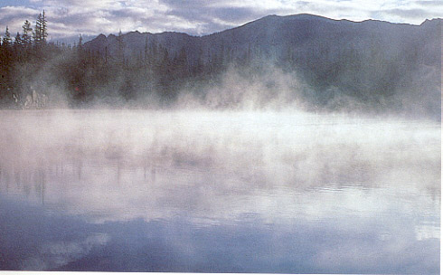
Water has a high latent heat of vaporization
As water evaporates from this lake, is heat added to or is it subtracted from the water body?
This Photo by Unknown Author is licensed under CC BY-SA
Notes:
The change from liquid to gas (or from gas to liquid) is especially dramatic. It requires 540 calories to be added to get liquid to boil, or turn to gas. And, it takes 540 calories to be subtracted to get water vapor to condense to liquid. The amount of energy that must be added or subtracted to bring about a change of state while the temperature remains constant is called the “latent heat”, and water has a remarkably high “latent heat of vaporization”. It takes a lot of energy to get water to go from liquid to gas.
So here is an example. It’s a hot day, and water is evaporating from a lake. What does that do to the water that is left behind in the lake? Pause the video if you want to think about it. (Pause.) It takes a lot of heat to make the liquid water turn into water vapor. So some of the energy is being taken from the water, meaning that water left in the lake may then be cooler.

Slide 24
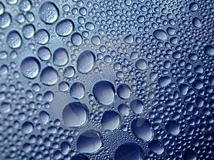
Practice Problem: Assuming equal volumes of water involved, which involves subtracting the most heat?
B. Using ice cubes to cool water
A. Making ice cubes
D. Water condensing on your window on a cold, humid day
C. Boiling water
All images: Creative Commons
Notes:
Here’s another practice problem. Let’s assume that all four scenarios shown involve the same amount of water. Which process involves subtracting the most heat? (Pause) First of all we are looking for processes that involve subtracting heat, so we are looking for processes that involve cooling. So we can eliminate C, boiling water. Using ice cubes to cool water (B) transfers the heat from the water to the melting of the ice cubes, so that process involves warming, even though it leaves the water in the glass cooler as the ice cubes warm up. A and D both involve cooling. But remember that the calories involved for gas to solid change are much greater that for a liquid to solid change, so D requires removing more calories than A.

Slide 25
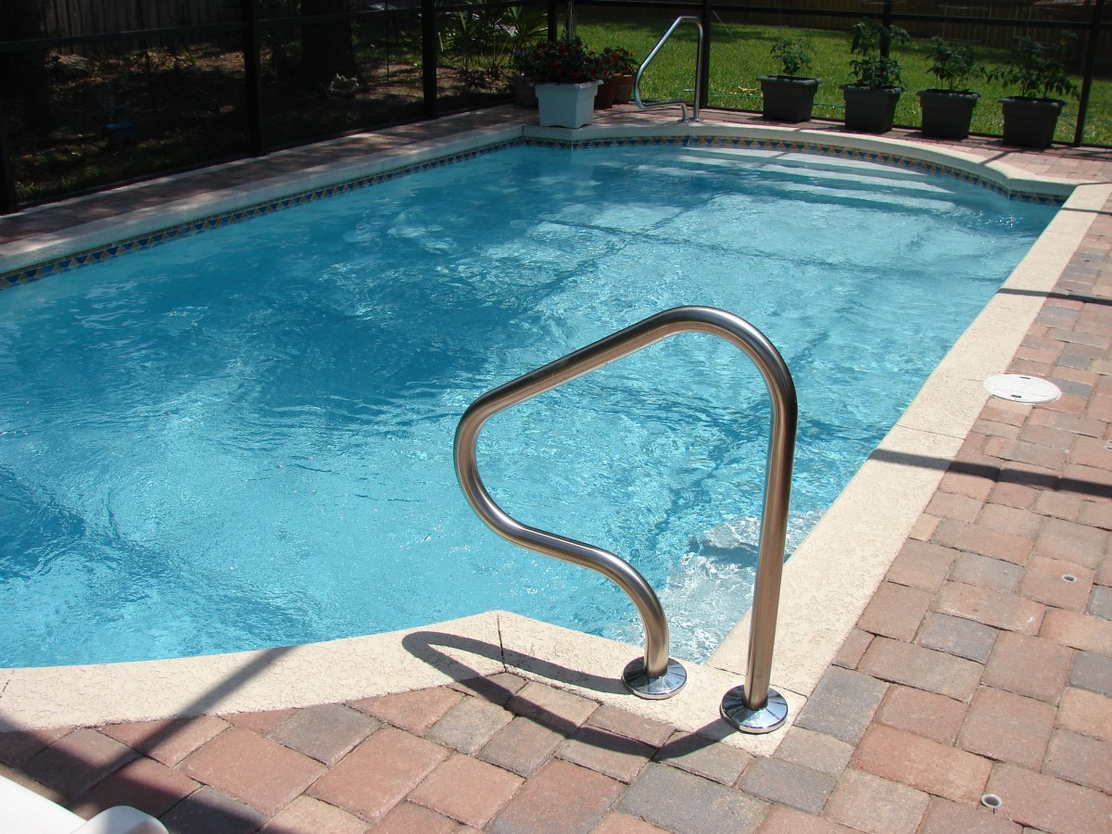
Specific heat is the amount of heat needed to be added or subtracted to change temperature
On a sunny day, which is most likely hotter, the patio or the surface of the pool?
Which has the highest specific heat?
Learn more about specific heat here
Image:
Creative Commons
Notes:
Let’s imagine ourselves in this scene. It’s a really hot day. Would you walk across this patio barefoot? Would you dive into this pool? You probably say no to the first and yes to the second. The warm sun will make the patio unbearably hot, yet seems to have little effect on the pool full of water. Specific heat is a term that refers to a substance’s ability to change temperature as it gives up or takes in heat. Water, unlike the patio, does not change its temperature readily. So we would say that water has a higher specific heat than the bricks of the patio do .

Slide 26
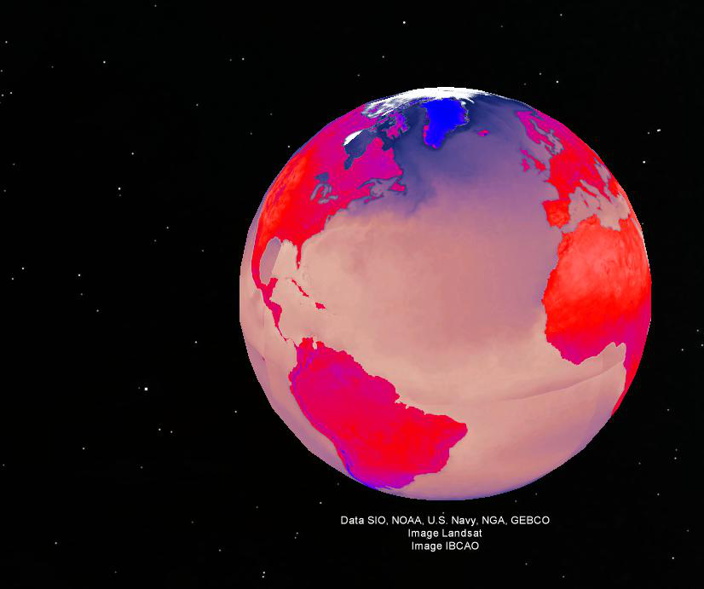
Water has the highest specific heat of all common substances
Land and sea surface average temperatures. Land varies from -50°C (blue) to 50°C (red). Sea surface varies from -2°C (blue) to 35°C (light pink).
Get these Google Earth overlays yourself here.
Notes:
In fact, water has the highest specific heat of all common substances. Here we are looking at a Google Earth image that shows us the average surface temperature for the land and the ocean. We see a range for both from very warm (red on land, light pink in the ocean) to cool (blue on land and in the ocean). But the difference between the coldest land and the warmest land is quite large, while in the ocean there is much less difference between the coldest ocean and the warmest ocean. The ocean, because it changes temperature more slowly than land does, is more uniform.

Slide 27
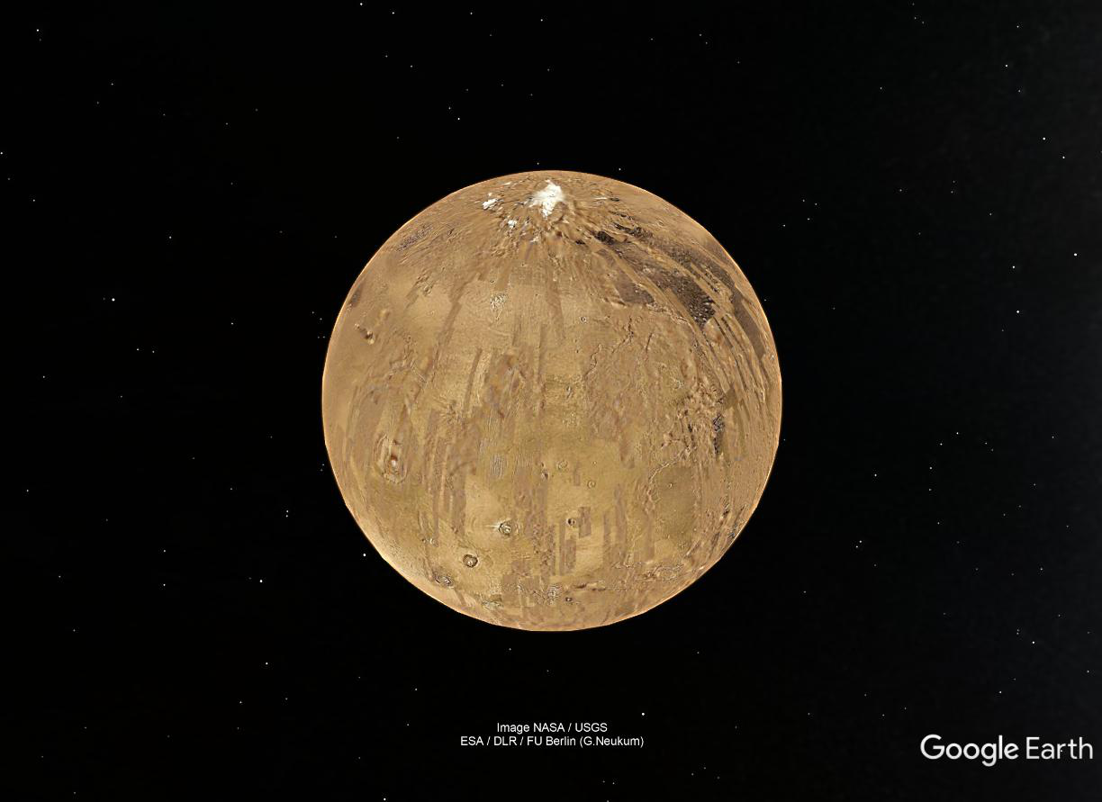
The specific heat of the ocean helps regulate our global climate!
Without water, how would the seasons be different on Earth?
Illustration: Google Earth Mars
Notes:
And that is really important! Without water, earth would just be a big rock moving through space, kind of like Mars, shown here, which has no oceans and very little water. Rocks change temperature easily. They heat up in the sunshine and cool down rapidly in the dark. So if Earth were just a big rock, daily and seasonal temperature changes would be much more dramatic than they are on our own mostly water-covered planet.

Slide 28
DENSITY & Viscosity
More unique properties of water
Notes:
Let’s move on to a couple more interesting aspects of water, its density and its viscosity. Again we’ll talk about what these words mean, and how these qualities apply to the ocean.

Slide 29
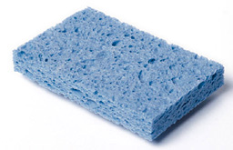
Density is mass per unit volume, for water measured in g/cm³
A
B
Practice Problem:
Which is more dense?
Microsoft clipart
Notes:
Like many terms we use in oceanography, density is one you probably already know. As we look at the sponge on the left and the glass egg on the right, you can probably already answer the question, which is more dense? The glass egg is more dense. But it would be a mistake to think it was more dense because it is heavier. Density is not the same as weight exactly. It is the mass (or weight) per a unit of volume. So if we had a cube of sponge that was the same size as a cube of glass, the glass would weigh more, or have more mass. Therefore it is more dense. But if you had a really huge sponge (maybe the size of a Volkswagen?) it might be heavier that the glass egg in the picture, but it would still be less dense.

Slide 30
Water is not easily compressed, so even at great depths (=high pressures), water is only slightly compressed
In the deepest part of the ocean, the water pressure is like an elephant standing on a postage stamp!
Read about pressure and depth here.
Microsoft clipart
Notes:
We know that the ocean is very deep, especially in some places. At great depths the pressure of all of the water is very high, like an elephant standing on a postage stamp. Some substances change their volume, and therefore their density with increased pressure. Imagine the elephant standing on the sponge. The sponge’s volume would be greatly decreased as the elephant squished it, or compressed it. Because it would now be smaller, it’s overall density would increase. But water does not compress easily. Water in the deepest part of the ocean is only slightly more dense than the water in the shallow part of the ocean. So while animals that live in the deep parts of the ocean must deal with really high water pressures, they don’t have to deal with water that noticeably denser than water in the more shallow parts of the ocean.

Slide 31
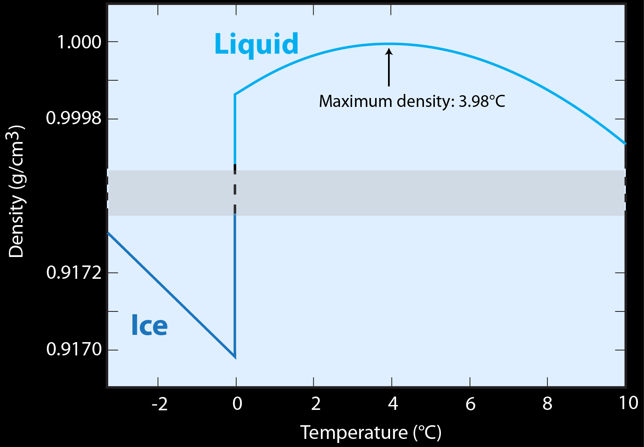
Water density does change with temperature change
Notes:
Water doesn’t easily change its density with pressure changes, but it DOES change density with temperature. Before we interpret this rather complicated-looking diagram, let’s think about what we already know about this from real life.

Slide 32
Practice problem: Which is more dense, liquid water or solid water?
This Photo by Unknown Author is licensed under CC BY-SA
Notes:
Here’s a practice problem. As we examine this picture, which is more dense, liquid water or solid water? Pause the video if you need to think about it. (Pause) This is a situation that we encounter all the time. Ice cubes float on ice water because the liquid form of water is denser than the frozen, solid form.

Slide 33
Water density does change with temperature change
Water as a solid is LESS dense than as a liquid!
Notes:
So, on this diagram, the X axis (the horizontal one) is temperature and the Y (vertical) axis is density. The bigger the number, the more dense the water is. The dark blue line represents ice, a solid, while the light blue line represents liquid water. So if we start at the lower left corner of the graph, we have ice that is about -4 in temperature and slightly more that 0.9172 g/cm³ in density. At we move to the right, the temperature warms as we add heat. As we add heat, we increase the kinetic energy of the water molecules. Because they are moving more, they are further apart, and the density decreases to about 0.9170 at 0 degrees.

Slide 34
Water density does change with temperature change
Water is most dense at 3.98°C. As the water heats up the kinetic energy of the molecules makes them move faster and stay further apart, decreasing density
Notes:
However, notice that when we add enough calories to change the ice to a liquid- 80 calories to be exact- the density suddenly increases dramatically to just over 0.9998 g/cm³! In fact, the increase is so dramatic that we have to have a break on the Y axis (shown in grey) to make it even fit. Once the water turns to a liquid, at 0 degrees, as we continue to add heat, notice that the density continues to increase, until we get to just under 4 degrees on the X axis—3.98°C to be exact. After that point, as we continue to add heat, the greater kinetic energy of the water molecules causes them to stay further apart, decreasing the density of water.

Slide 35
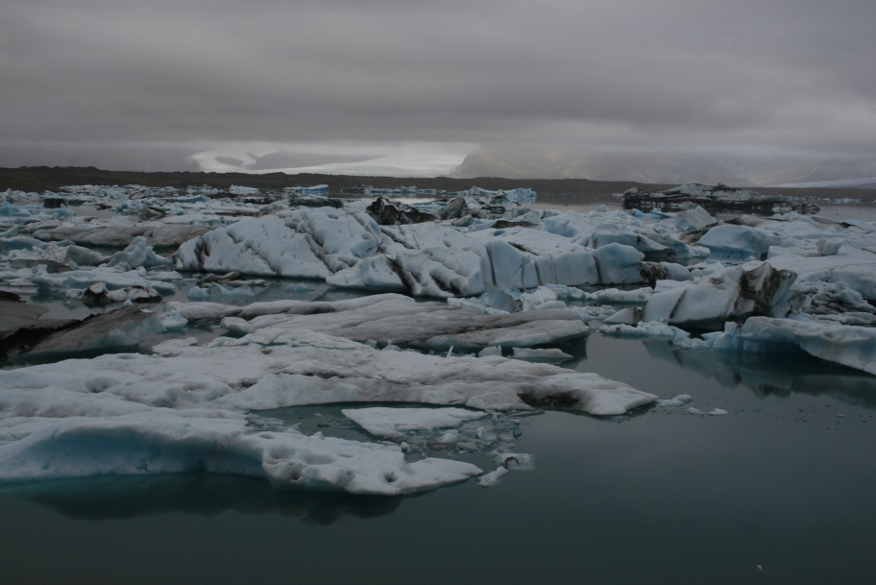
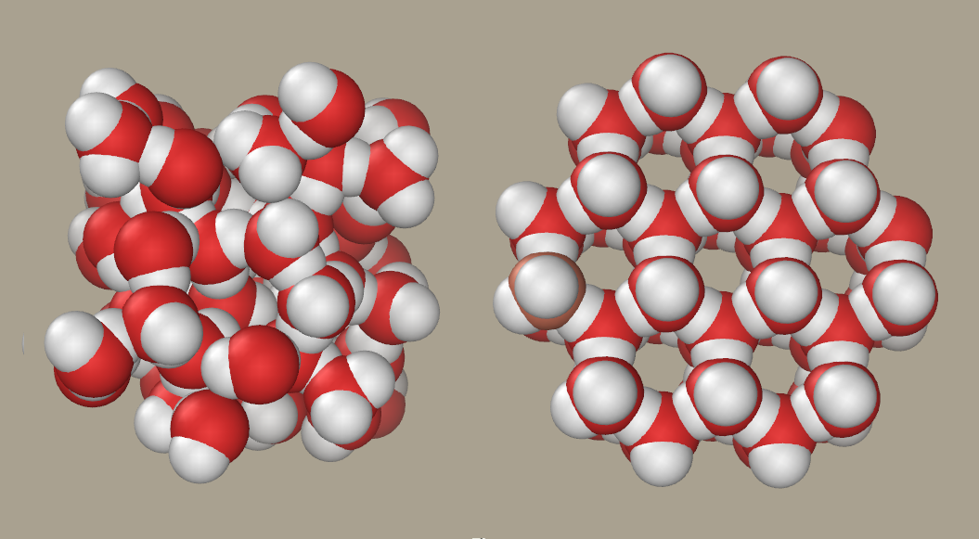
When ice forms, the water molecules organize into a lattice, with more space between them
Liquid Solid
Icebergs near Iceland, left, R. Freeman; Right image: Creative Commons Attribution-Share Alike 3.0 Unported license.
Notes:
OK, so both ice and liquid water warmer than 3.98°C become less dense as you add heat. So why is it that ice, with less kinetic energy per volume, is LESS dense that liquid water with more kinetic energy?
Even within liquid water, a certain number of molecules have bonded together, as we have discussed. But in liquid water, the bonds are random and disorganized, and the water molecules can fit tightly together. When liquid water turns to solid water, the molecules start to bond in a much more organized way, forming a three-dimensional lattice, as shown on the right. Notice that this organized structure includes more empty space than we see in the disorganized jumble to the left, representing liquid water. This organized structure, with more space, is the reason solid water is less dense that liquid. This is why ice floats-be it ice cubes in your glass of water or icebergs in the ocean. This chemical property of water is what brought down the Titantic!

Slide 36
Practice problem: You are drying the dishes after washing them one night. You wipe a cloth across a pan, but tiny beads of moisture remain on the side of the pan. What property of water was demonstrated here? 1) Water has a high specific heat. 2) Water has a high heat of vaporization. 3) Water is the universal solvent. 4) Water molecules form hydrogen bonds with each other, demonstrating cohesion.
Microsoft clipart
Notes:
Alright, let’s try to apply some of the concepts we’ve learned thus far in this lesson. We’ll be doing some similar problems in class. Read the scenario and then pick the best possible explanation for it from the list. (Pause) As you wiped the water off the pan, the water that was not absorbed by the dishcloth formed beads. Why did it do that? Why didn’t it form a thin uniform layer? The answer here is 4. Water molecules like to bond with one another, exhibiting cohesion, even more than they like to bond to other substances, like the pan, the property we call adhesions The water molecules are pulled together into droplets or beads as they bond. Answers 1 and 2 involve changing temperature which was not mentioned in the scenario. Answer 3 is also a correct statement about water but does not apply to the scenario.

Slide 37
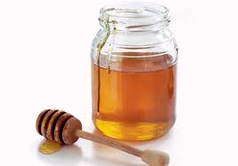
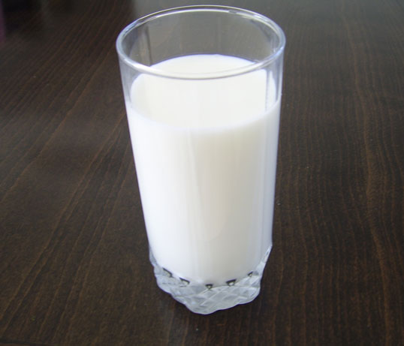
Viscosity is resistance to motion or internal friction
A
B
Which is more viscous?
Microsoft clipart
Notes:
Viscosity is another term you probably already know, even before I define it. Technically, viscosity in resistance to motion or internal friction. But we could think of it in terms of pouring a liquid out of a jar or glass. We know the milk will pour much more easily that the honey. The honey has a high viscosity- it resists pouring out of the jar. If we tossed something into the milk (maybe a cookie?) it would easily sink into the milk. If we tossed a cookie into the jar of honey, it would probably remain on top because of the honey’s viscosity.

Slide 38
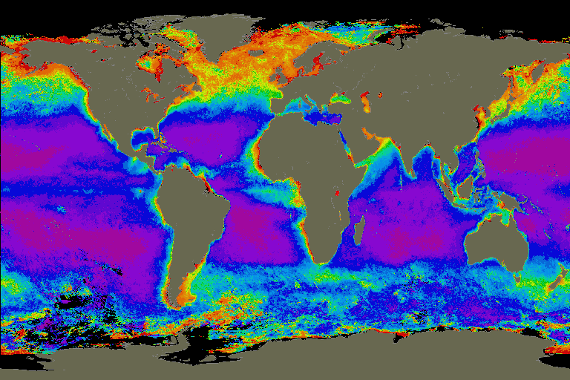
Water has a low viscosity, and warm water is less viscous than colder water
Planktonic organisms (those that float in the ocean) have an easier time floating in colder water!
Red and orange indicate high concentrations of phytoplankton. Concentrations decrease as you go down the color spectrum.
Image from NASA's SeaWiFS mission
Notes:
Water has different viscosities at different temperatures. It is more viscous when cold and less viscous when warm. The difference isn’t nearly as great as the difference between honey and milk, but does make a difference to some of the smallest things that live in the ocean. Plankton are organisms that float in the ocean. Most of them are very tiny. It is easier for them to float and not sink when the water is cold and viscous. Many of them are photosynthetic, like plants on land, and can be detected by satellites in space. The map to the right shows us concentrations of these plankton in the ocean. Red and yellow colors indicate lots of plankton, while blue and purple colors indicate very few. Notice that the plankton are more abundant near the North and South Poles, where the water is cold than they are anywhere else! The viscosity of the water is not the only reason plankton are abundant near the poles, but it’s certainly a contributing factor.

Slide 39
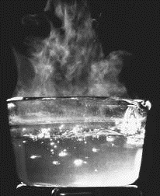
Practice problem: Why is cold water more viscous that hot water?
This Photo by Unknown Author is licensed under CC BY-SA
Notes:
Before we wrap up, here’s another practice problem. We talked about how cold water is more viscous that hot water, but we didn’t discuss the reason. Using the knowledge of the water molecule that you have gained in this lesson, you should be able to determine this for yourself. I’ll give you a moment to hit pause if you need to think about it. (Pause)

Slide 40
Practice problem: Why is cold water more viscous than hot water?
HINT: Which has more kinetic energy?
This Photo by Unknown Author is licensed under CC BY-SA
Notes:
Are you still stuck? Here’s a hint if you want to think about it a little more. (Pause) Remember that temperature is a measurement of kinetic energy. So in hot water the water molecules are moving around a lot, whereas in cold water less so. Also remember that water molecules constantly form hydrogen bonds with each other. So in which body of water would you expect to find more bonds, which is what gives water internal structure? The viscosity is a reflection of this internal structure, and in cold water, we’d expect more bonds and more internal structure.

Slide 41
Summary: Water has the following unique combination of qualities:
A) H₂O molecules form hydrogen bonds with each other. They are cohesive.
B) H₂O molecules like to bond with ions or other charged molecules. They are adhesive.
C) Because water bonds easily with other ions, it is the “universal solvent”.
D) Water has a high specific heat.
E) Water has a high heat of vaporization.
F) Water’s greatest density is at 4°C. Above or below that temperature it becomes less dense.
G) Water has a low viscosity.
Notes:
We’ve learned a lot about water, and here is a summary of some key points. Review each of these statements and make sure you understand it and could apply it. In class we will do an exercise where we will apply these concepts to situations involving water in every day life. If you go back to review, be sure to follow the embedded hyperlinks in the accompanying powerpoint for more information and review. Thanks for listening!

